Slide 1

Final Project Software
Marc Arjol Rodríguez |CST 499- Capstone

Slide 2
Agenda
Introduction
SRS Document
UML Design Model
Landing, Log in, and Enrollment Pages
MySQL Database
PHP Code
Website Design
Conclusion
Reference List

Slide 3
Introduction
In this presentation, we will provide an overview of the key aspects of the software development process for the University Student Portal. We will showcase the Software Requirements Specification (SRS) document, the UML design model, the landing, login, and enrollment pages, the MySQL database, and the PHP code developed for the course project. These components collectively contribute to the successful creation of the Student Portal, ensuring its functionality, usability, and performance.

Slide 4
Software Requirements Specification (SRS) Document
The Software Requirements Specification (SRS) document is a crucial starting point for any software development project. It outlines the functional and non-functional requirements of the University Student Portal, capturing the needs and expectations of stakeholders, including students, faculty, and administrators. The SRS document contains detailed descriptions of the features, user interfaces, and system constraints, ensuring that the development team has a clear understanding of what needs to be built.

Slide 5
UML Design Model
The Unified Modeling Language (UML) design model is a visual representation of the architecture and design of the University Student Portal. It includes various types of diagrams, such as class diagrams, sequence diagrams, activity diagrams, and use case diagrams. These diagrams provide a graphical view of the system's components, relationships, and interactions, facilitating effective communication among team members and stakeholders. The UML design model acts as a blueprint for developers, helping them understand how different parts of the system will work together.

Slide 6
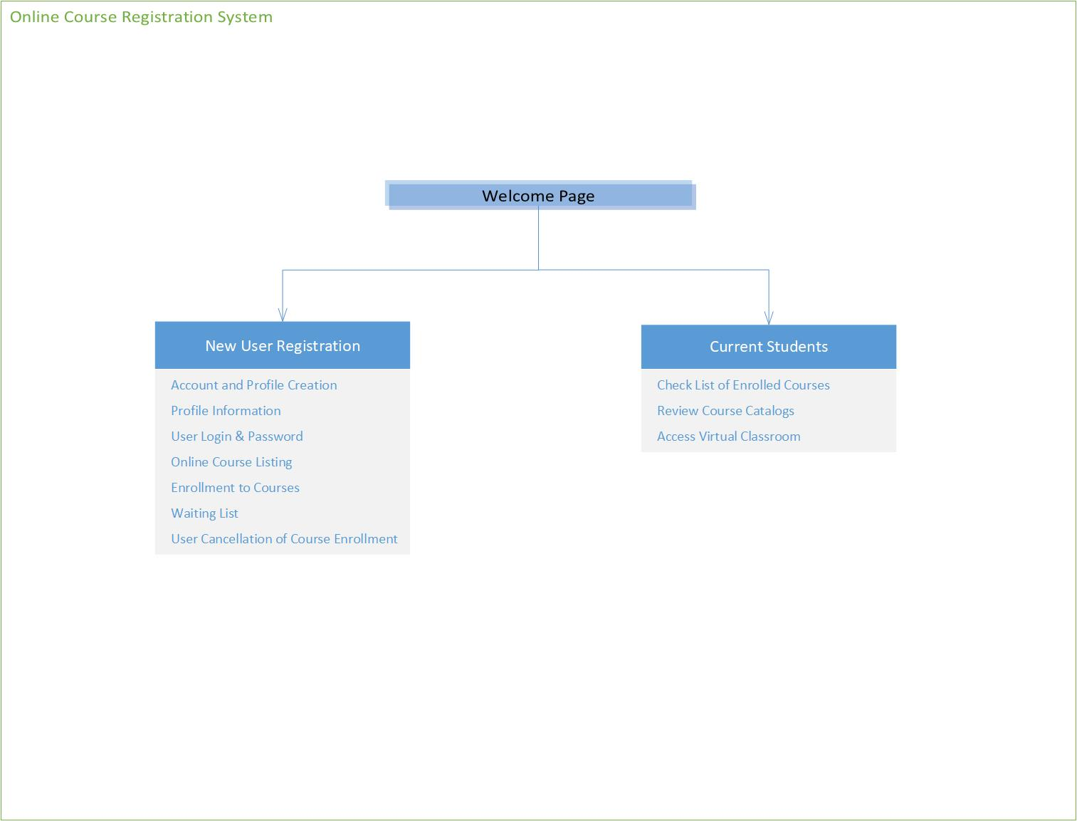
UML Design Model

Slide 7
Landing, Log in, and Enrollment Pages
The landing page of the University Student Portal is the first page users encounter when they access the website. It serves as a welcoming and informative introduction to the portal, providing a brief overview of its features and benefits. The design of the landing page should be visually appealing and intuitive, encouraging users to explore further.
The login page is a critical component that ensures the security of the Student Portal. It allows users to authenticate their identities by entering their credentials, such as username and password. The login process must be secure and robust to prevent unauthorized access to sensitive student data.
The enrollment page is designed to facilitate the course registration process for students. It should display available courses, class schedules, and relevant course information. The design should be user-friendly, enabling students to select and enroll in their desired classes with ease.

Slide 8
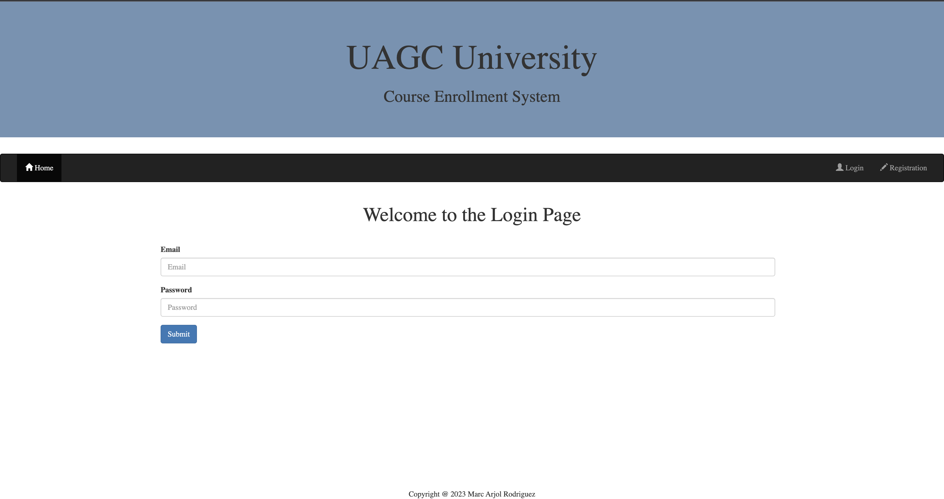
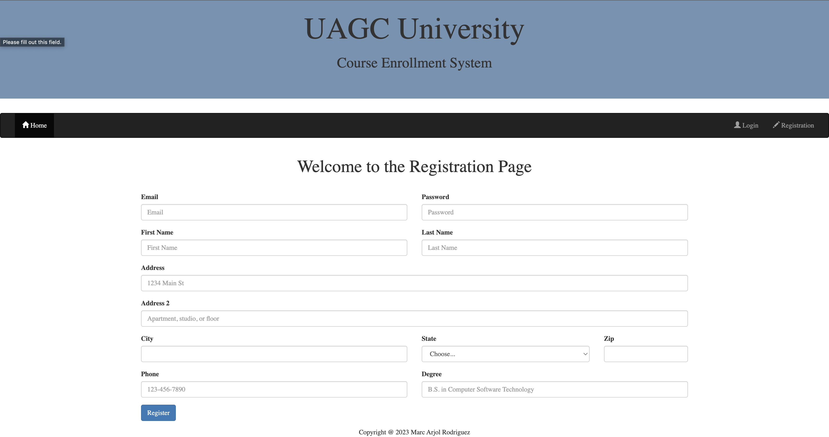
Website Design
Registration Page

Slide 9
Website Design
Login Page

Slide 10
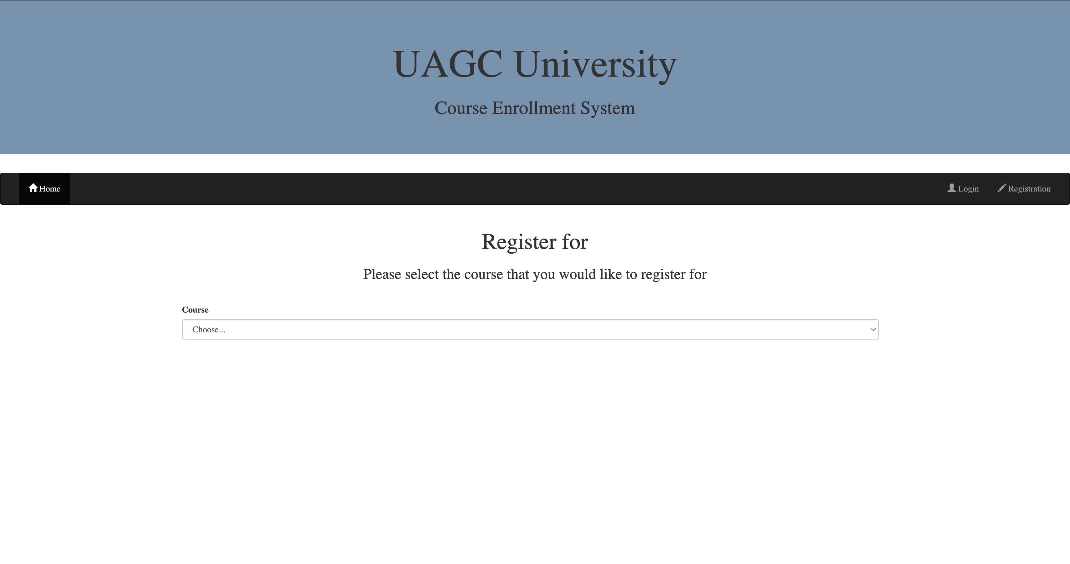
Website Design
Course Enrollment System

Slide 11
MySQL Database
The MySQL database serves as the backend storage system for the University Student Portal. It stores and manages essential data, such as student profiles, course details, and enrollment records. The database ensures data integrity and provides efficient retrieval and updating of information.
The class registration functionality is a critical feature of the Student Portal. It enables students to browse available courses, view class schedules, and register for classes. When a student registers for a class, the enrollment information is stored in the MySQL database, and the system updates the class capacity accordingly.

Slide 12
MySQL Database
The first code class (‘created.sql’), creates the Database called ‘course_enrollment_system’, and created several tables inside the DB to enable the functionality of the website. As seen in the next slide, the tables are: ‘student’, ‘course’, ‘offering’, waitlist’, ‘enrollment’, and ‘notification’.
The second class (‘populateData.sql’), sets the format for the data in the database table, and stores all the data information, as seen in the slide below.
‘student’: (`email`, `password`, `firstName`, `lastName`, `address`, `phone`, `degree`)
‘course’: (`courseName`, `maxStudents`)
‘offering’: (`course_id`, `year`, `semester`)
‘enrollment’: (`student_id`, `offering_id`)
‘waitlist’: (`student_id`, `offering_id`, `dateTimeAdded`)

Slide 13
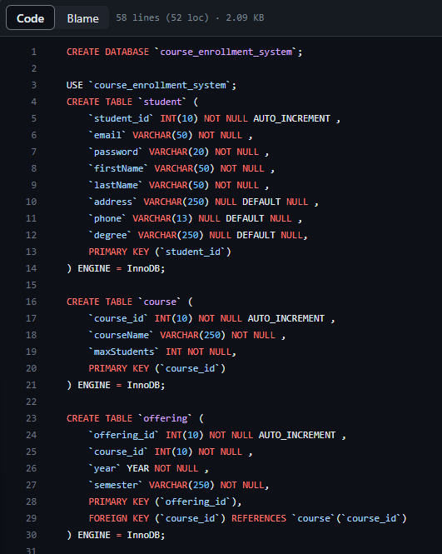
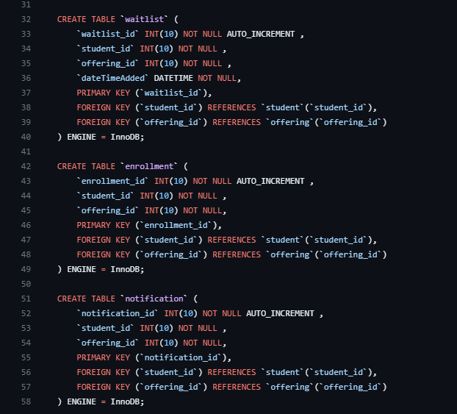
MySQL Database ‘created.sql’

Slide 14
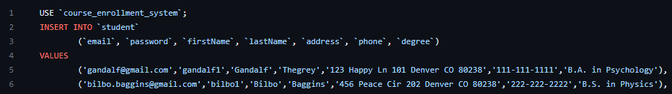
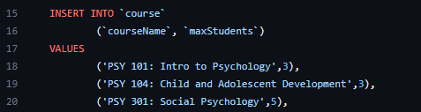
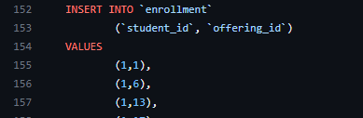
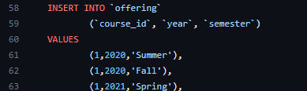
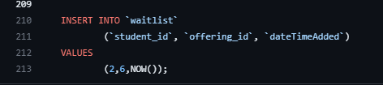
MySQL Database ‘populateData.sql’

Slide 15
PHP Code
PHP is a server-side scripting language used to develop dynamic web pages and web applications. In the context of the University Student Portal, PHP code is responsible for processing user inputs, interacting with the MySQL database, and generating dynamic content for the web pages.
For example, when a student submits a registration form, the PHP code handles the form data, validates it, and stores the enrollment details in the database. The PHP code also interacts with the database to retrieve course information and display it on the web pages dynamically.

Slide 16
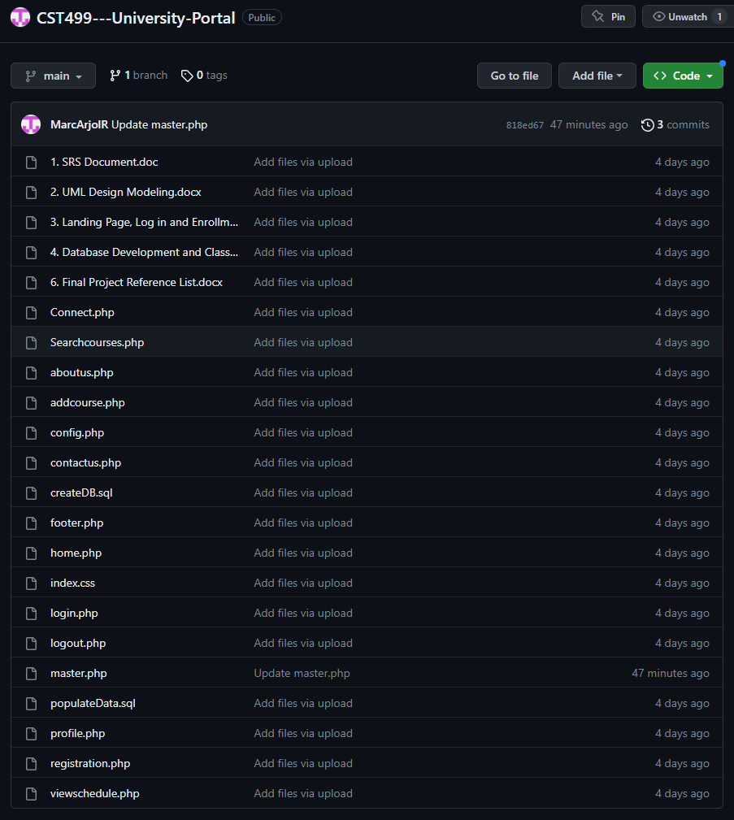
PHP Code
The project has a total of 17 classes, where PHP language stablishes a 99.7% of the total language, with CSS being used on a 0.3%.

Slide 17
Conclusion
In conclusion, the development of the University Student Portal involves various components, including the SRS document, the UML design model, landing, login, and enrollment page designs, the MySQL database, and the PHP code. Each of these components plays a crucial role in creating a robust, user-friendly, and feature-rich platform for students, faculty, and administrators to manage academic activities effectively. By incorporating these elements into the development process, the University Student Portal will be well-equipped to meet the needs and expectations of its users.

Slide 18
Reference List
Connolly, R., & Hoar, R. (2018). Fundamentals of web development (2nd ed.). Pearson.
Developer Mozilla (December, 2022) <ul>: The Unordered List element. Retrieved from https://developer.mozilla.org/en-US/docs/Web/HTML/Element/ul
Developer Mozilla (December, 2018) <script>: The Script Element. Retrieved from https://developer.mozilla.org/en-US/docs/Web/HTML/Element/script#:~:text=The%20HTML%20element%20is,shader%20programming%20language%20and%20JSON.&text=Metadata%20content%2C%20Flow%20content%2C%20Phrasing%20content.
IEEE Std 830-1998. (1998). IEEE Recommended Practice for Software Requirements Specifications. IEEE Computer Society.
Kotonya, G., & Sommerville, I. (1998). Requirements Engineering: Processes and Techniques. Wiley.
Myers, G. J., Sandler, C., & Badgett, T. (2011). The Art of Software Testing (3rd ed.). Hoboken, NJ: John Wiley & Sons.
Pressman, R. S. (2010). Software Engineering: A Practitioner's Approach (7th ed.). McGraw-Hill.
Sommerville, I. (2011). Software Engineering (9th ed.). Addison-Wesley.
Tsui, F., Karam, O., & Bernal, B. (2018). Essentials of software engineering (4th ed.). Jones & Bartlett Learning.

